Slide 1

REAL ESTATE price prediction
Machine learning MINI PROJECT

Slide 2

OBJECTIVE
The objective of this project is to do predictive analysis which is based on supervised machine learning.
The dataset is obtained from Kaggle :
https://www.kaggle.com/amitabhajoy/Bengaluru- house-price-data
The analysis and model creation can be found in the .ipynb file.
The main packages used are numpy, pandas, matplotlib, seaborn and sklearn.
MACHINE LEARNING

Slide 3




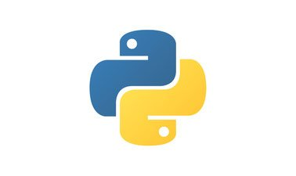


Tech Requirements
MODEL CREATION
PYHTON LIBRARIES

Slide 4

4 steps process
DATA PREPROCESSING
TRAIN TEST SPLITTING
COMPARING MODEL RESULTS
CROSS VALIDATION

Slide 5
Data preprocessing
Handling missing values
Dimensionality reduction
Outliers removal

Slide 6
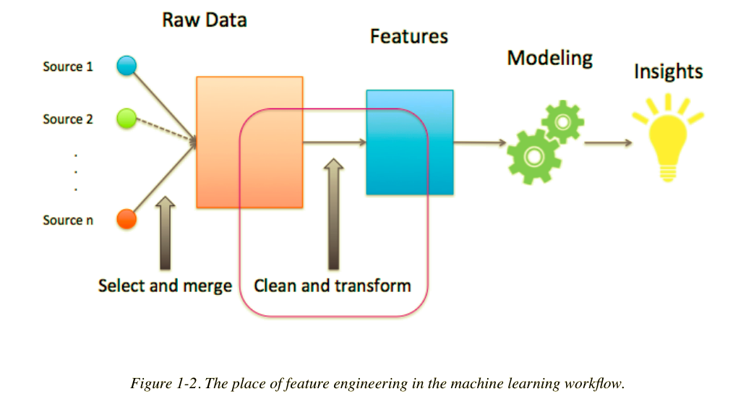
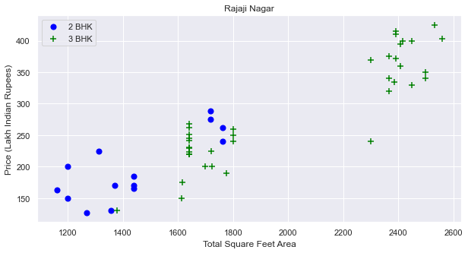
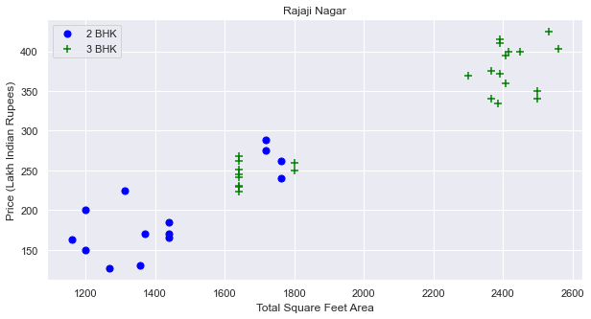
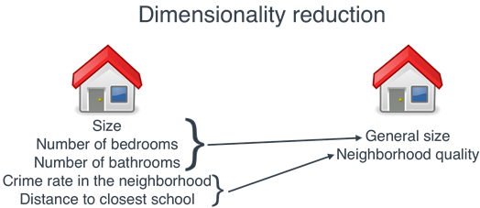
BEFORE AND AFTER OUTLIER REMOVAL: RAJAJI NAGAR
MISSING DATA HANDLING

Slide 7
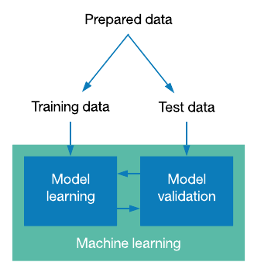
Train-test splitting
The procedure involves taking a dataset and dividing it into two subsets:
Train Dataset:
Used to fit the machine learning model
Test Dataset:
Used to evaluate the fit machine learning model

Slide 8
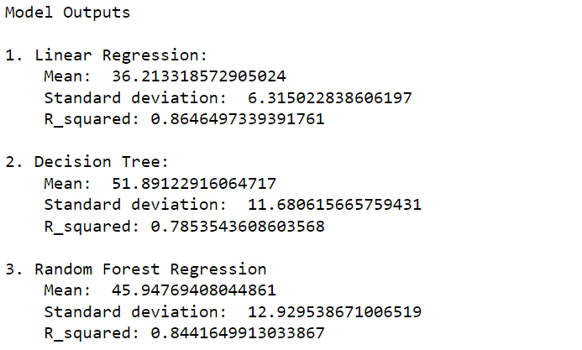
Comparing model results
We will choose Linear Regression for our model since error is least with it.

Slide 9
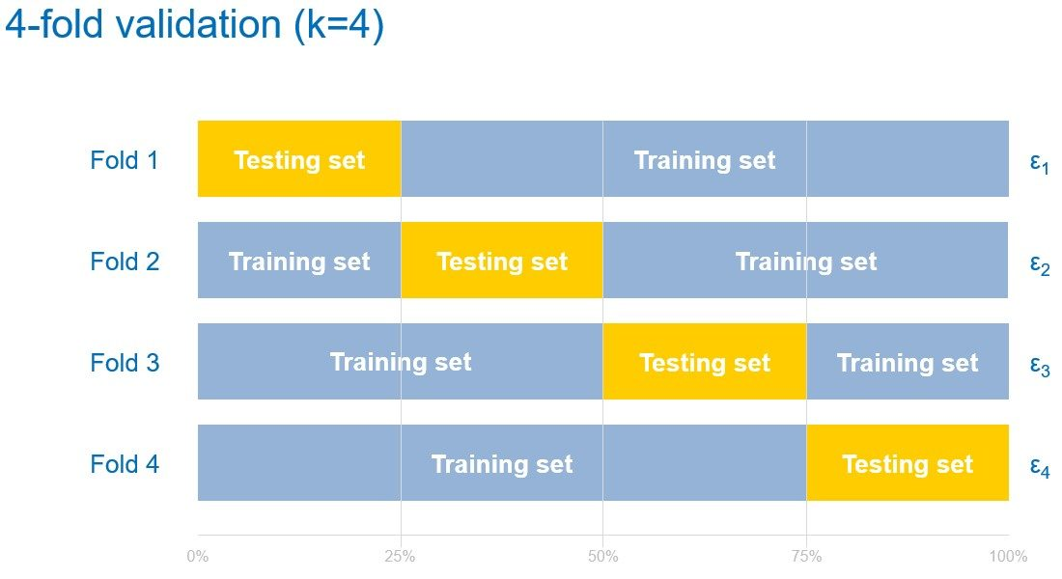
Cross validation
The three steps involved in cross-validation are as follows :
1
Reserve some portion of sample data-set.
2
Using the rest data-set train the model.
3
Test the model using the reserve portion of the data-set.

Slide 10
outcomes
We are doing supervised machine learning because we are provided with labelled data
This is a regression problem in machine learning as house prices is a continuous variable
Also R-squared value is best for Linear regression
Linear regression is chosen since error is least with it

Slide 11
References
O Theobald, Machine Learning For Absolute Beginners: A Plain English Introduction (Second Edition), ‎ Scatterplot Press, 2017, pp. 122-35
Aurélien Géron, Hands-On Machine Learning with Scikit-Learn, Keras, and TensorFlow: Concepts, Tools, and Techniques to Build Intelligent Systems 2nd Edition, O'Reilly Media, 2019
Andriy Burkov, The Hundred-Page Machine Learning Book Paperback, 2019
Trevor Hastie, The Elements of Statistical Learning: Data Mining, Inference, and Prediction, Second Edition (Springer Series in Statistics), Springer, 2017
Zed Shaw, Learn Python the Hard Way: A Very Simple Introduction to the Terrifyingly Beautiful World of Computers and Code (Zed Shaw's Hard Way Series), Addison-Wesley, 2013, pp 150-155

Slide 12

Thank You
CREATED BY:
VANSH CHOPRA
2000910130123
IT-2

